Slide 1
Chapter 7: Transport Layer
Introduction to Networking
Notes:
Cisco Networking Academy program
Introduction to Networking
Chapter 7

Slide 2
Chapter 7
7.1 Transport Layer Protocols
7.2 TCP and UDP
7.3 Summary
Notes:
Chapter 5

Slide 3
Chapter 7: Objectives
Describe the purpose of the transport layer in managing the transportation of data in end-to-end communication.
Describe characteristics of the TCP and UDP protocols, including port numbers and their uses.
Explain how TCP session establishment and termination processes facilitate reliable communication.
Explain how TCP protocol data units are transmitted and acknowledged to guarantee delivery.
Explain the UDP client processes to establish communication with a server.
Determine whether high-reliability TCP transmissions, or non-guaranteed UDP transmissions, are best suited for common applications.

Slide 4
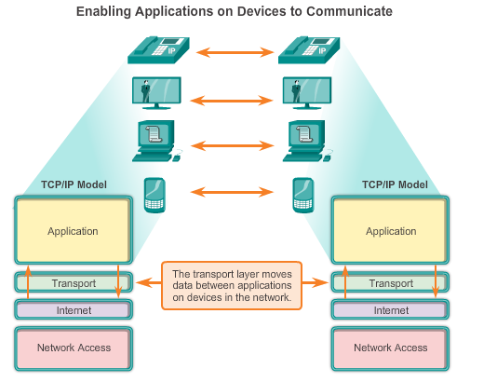
Role of the Transport Layer
Notes:
Chapter 7
7.1.1

Slide 5
Transportation of Data Role of the Transport Layer
The Transport Layer is responsible for establishing a temporary communication session between two applications and delivering data between them. TCP/IP uses two protocols to achieve this:
Transmission Control Protocol (TCP)
User Datagram Protocol (UDP)
Primary Responsibilities of Transport layer Protocols
Tracking the individual communication between applications on the source and destination hosts
Segmenting data for manageability and reassembling segmented data into streams of application data at the destination
Identifying the proper application for each communication stream
Notes:
7.1.1.1 and 7.1.1.2 Role of the Transport Layer

Slide 6
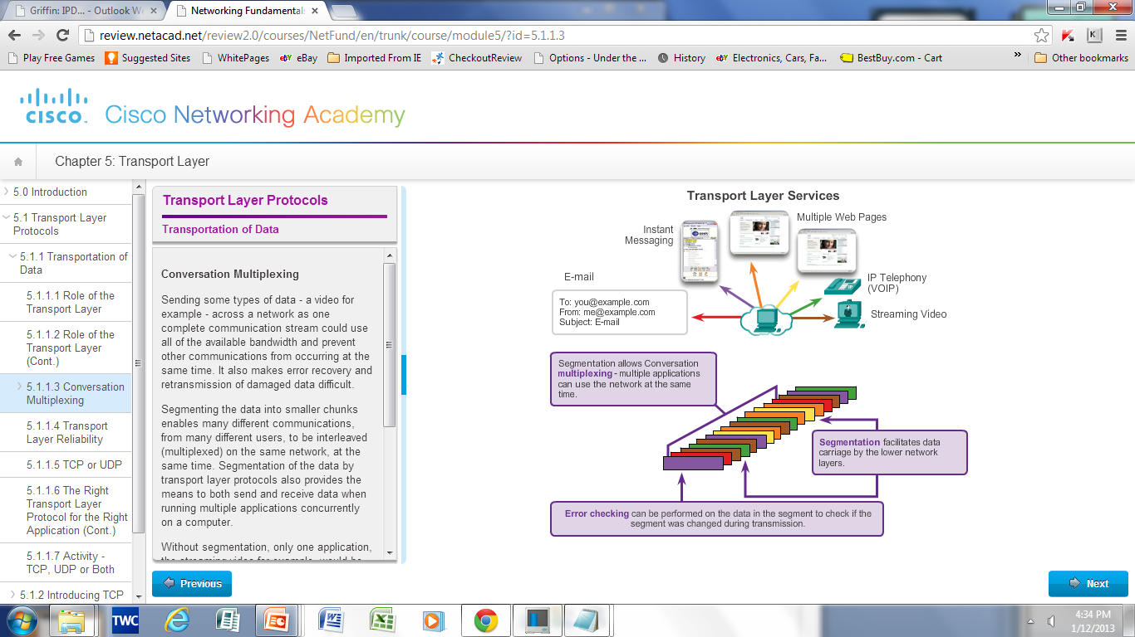
Transportation of Data Conversation Multiplexing
Segmenting the data
Enables many different communications, from many different users, to be interleaved (multiplexed) on the same network, at the same time.
Provides the means to both send and receive data when running multiple applications.
Header added to each segment to identify it.
Notes:
7.1.1.3 Conversation Multiplexing

Slide 7
Transportation of Data Transport Layer Reliability
Different applications have different transport reliability requirements
TCP/IP provides two transport layer protocols, TCP and UDP
Transmission Control Protocol (TCP)
Provides reliable delivery ensuring that all of the data arrives at the destination.
Uses acknowledged delivery and other processes to ensure delivery
Makes larger demands on the network – more overhead
User Datagram Protocol (UDP)
Provides just the basic functions for delivery – no reliability
Less overhead
TCP or UDP
There is a trade-off between the value of reliability and the burden it places on the network.
Application developers choose the transport protocol based on the requirements of their applications.
Notes:
7.1.1.4 Transport Layer Reliability
7.1.1.5 TCP
7.1.1.6 UDP
7.1.1.7 The Right Transport Layer Protocol for the Right Application

Slide 8
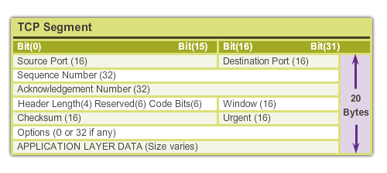
Introducing TCP and UDP Introducing TCP
Transmission Control Protocol (TCP)
RFC 793
Connection-oriented – creating a session between source and destination
Reliable delivery – retransmitting lost or corrupt data
Ordered data reconstruction – numbering and sequencing of segments
Flow control - regulating the amount of data transmitted
Stateful protocol – keeping track of the session
Notes:
7.1.2 Introducing TCP and UDP
7.1.2.1 Introducing TCP
7.1.2.2 Role of TCP

Slide 9
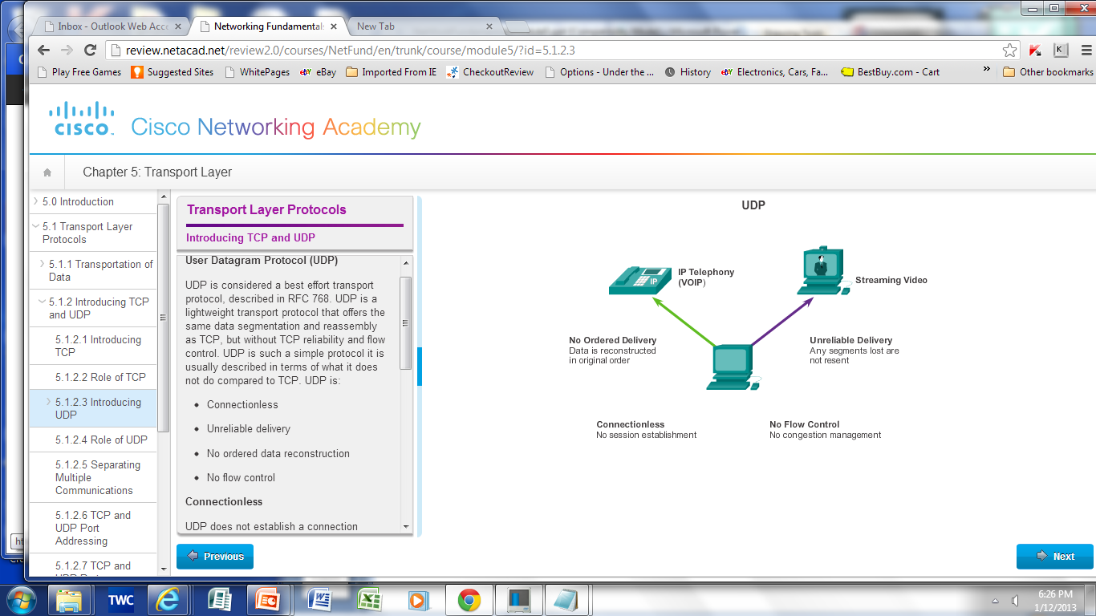
Introducing TCP and UDP Introducing UDP
User Datagram Protocol (UDP)
RFC 768
Connectionless
Unreliable delivery
No ordered data reconstruction
No flow control
Stateless protocol
Applications that use UDP:
Domain Name System (DNS)
Video Streaming
Voice over IP (VoIP)
Notes:
7.1.2.3 Introducing UDP
7.1.2.4 Role of UDP

Slide 10
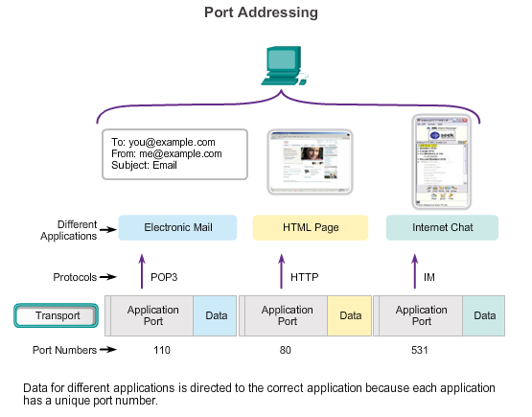
Introducing TCP and UDP Separating Multiple Communications
Port Numbers are used by TCP and UDP to differentiate between applications.
.
Notes:
7.1.2.5 Separating Multiple Communications
7.1.2.6 TCP and UDP Port addressing

Slide 11
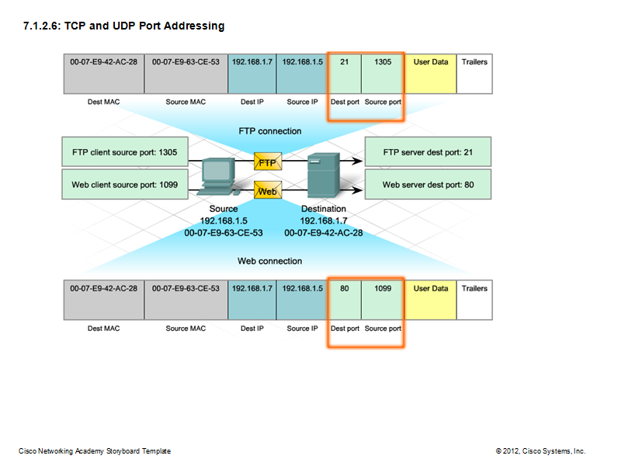
Introducing TCP and UDP TCP and UDP Port Addressing
Notes:
7.1.2.7 TCP and UDP Port Addressing

Slide 12
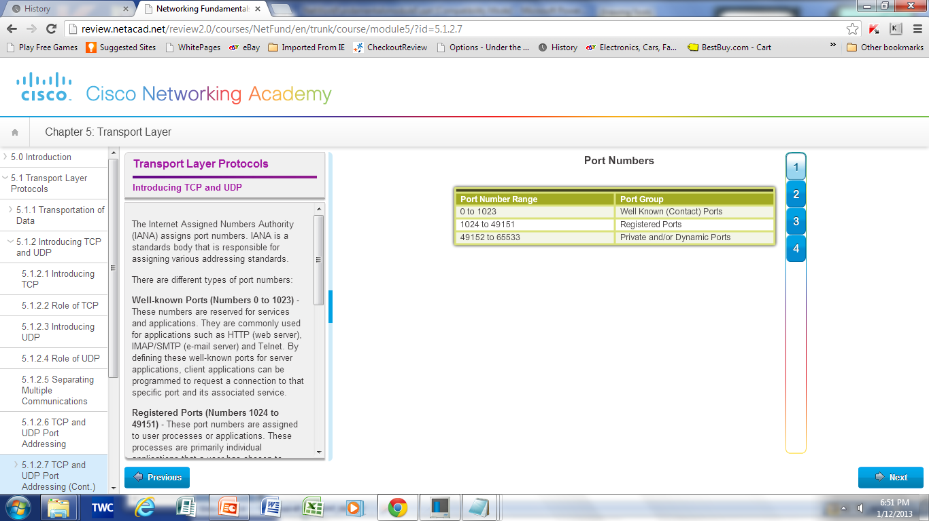
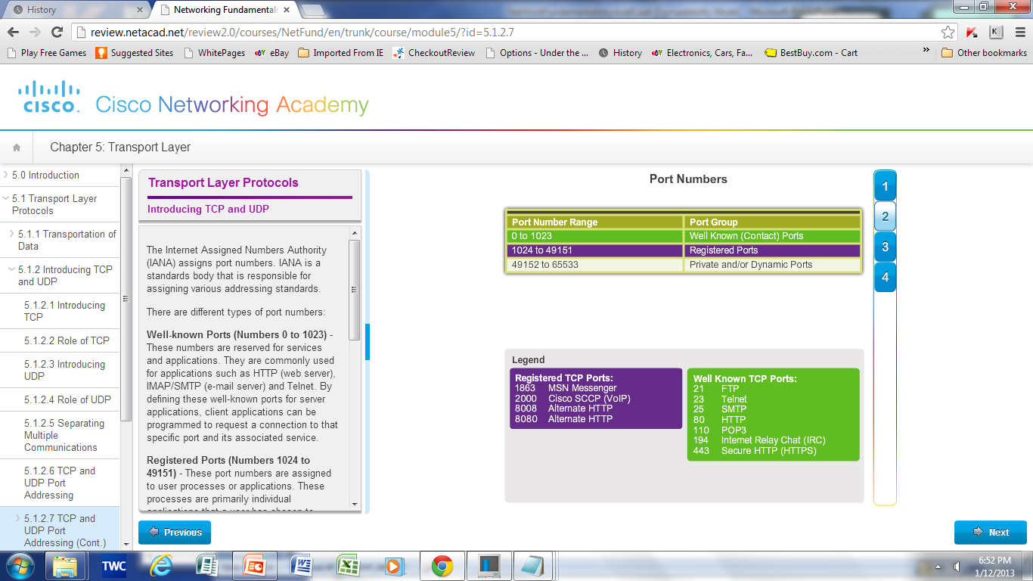
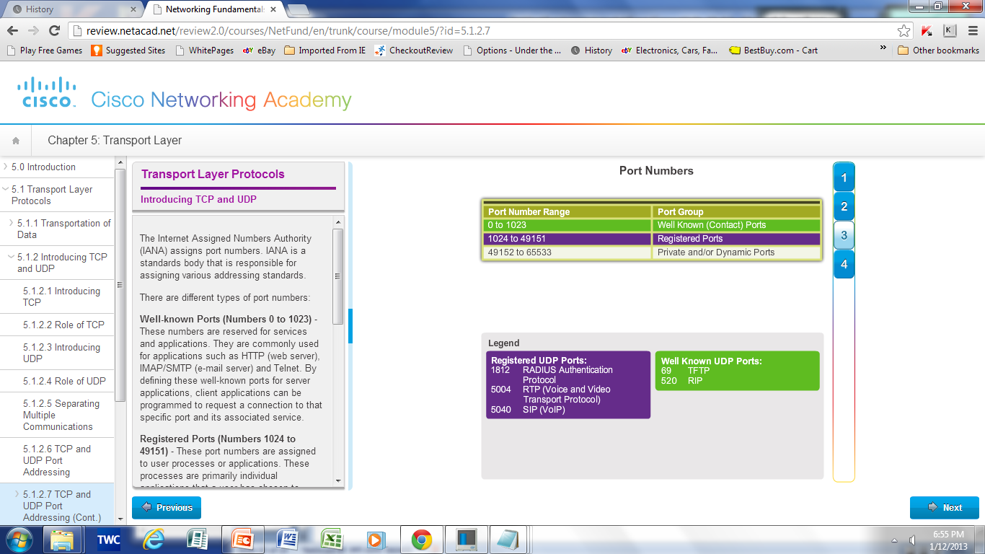
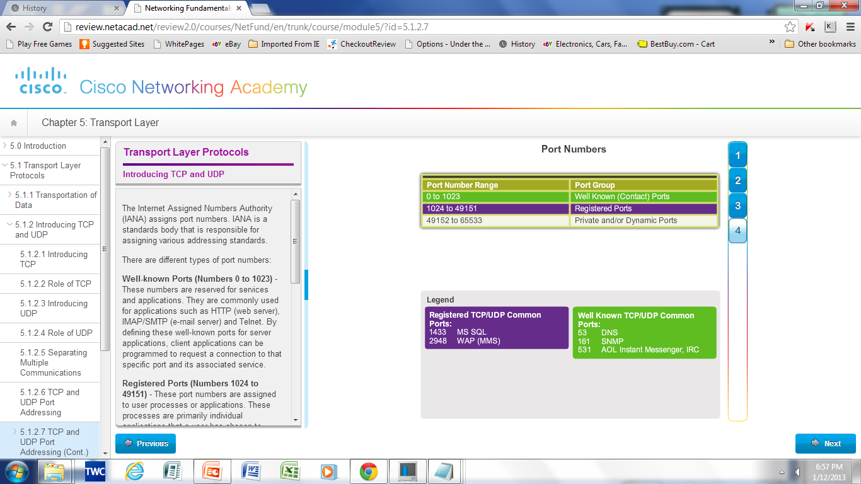
Introducing TCP and UDP TCP and UDP Port Addressing
Notes:
7.1.2.8 TCP and UDP Port Addressing (cont)

Slide 13
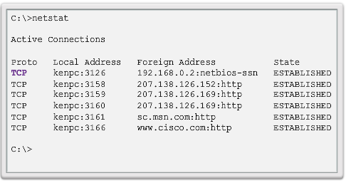
Introducing TCP and UDP TCP and UDP Port Addressing
Netstat
Used to examine TCP connections that are open and running on a networked host
Notes:
7.1.2.9 TCP and UDP Port Addressing (cont)

Slide 14
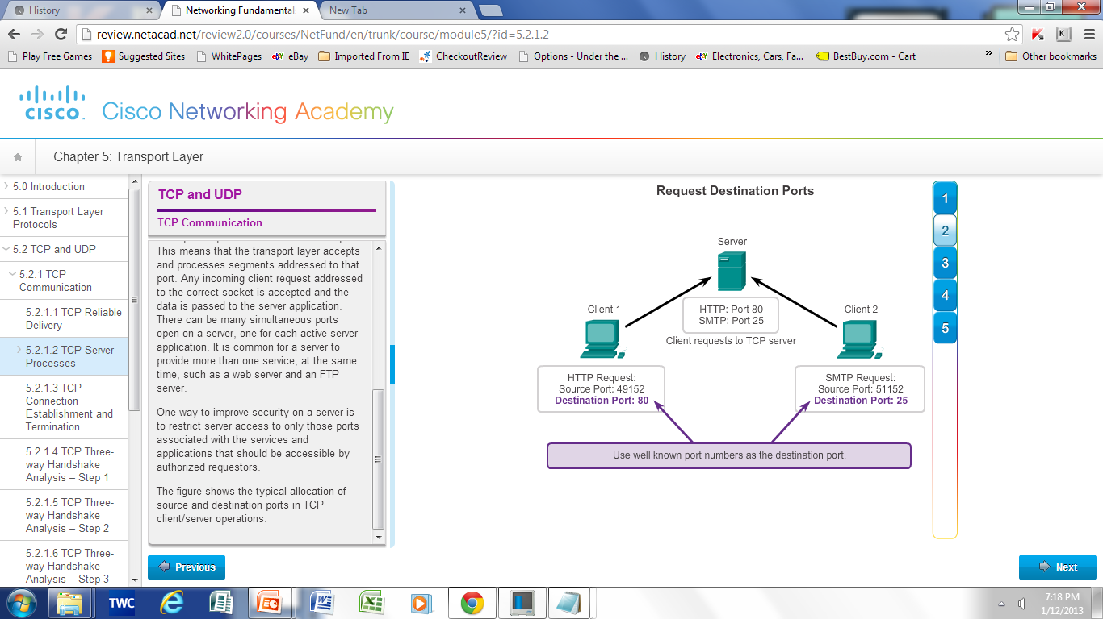
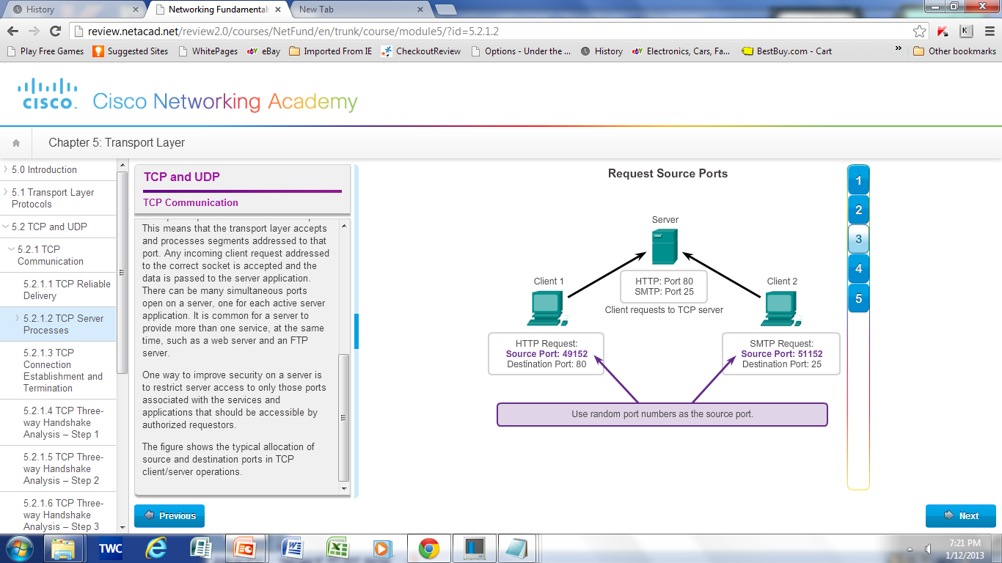
TCP Communication TCP Server Processes
Notes:
7.2.1 TCP Communication
7.2.1.2 TCP Server Processes

Slide 15
TCP Communication TCP Connection, Establishment and Termination
Three-Way Handshake
Establishes that the destination device is present on the network.
Verifies that the destination device has an active service and is accepting requests on the destination port number that the initiating client intends to use for the session.
Informs the destination device that the source client intends to establish a communication session on that port number.
Notes:
7.2.1.3 TCP Connection, Establishment and Termination

Slide 16
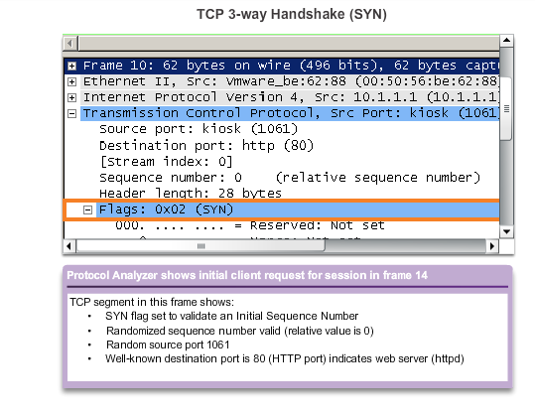
TCP Communication NEED New Graphic for this and next two slides TCP Three-Way Handshake – Step 1
Step 1: The initiating client requests a client-to-server communication session with the server.
Notes:
7.2.1.4 TCP Three Way Handshake – Step 1

Slide 17
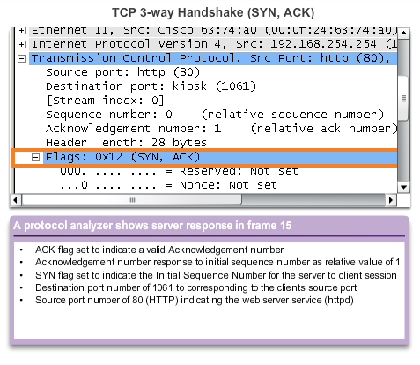
TCP Communication TCP Three-Way Handshake – Step 2
Step 2: The server acknowledges the client-to-server communication session and requests a server-to-client communication session.
Notes:
7.2.1.5 TCP Three Way Handshake – Step 2

Slide 18
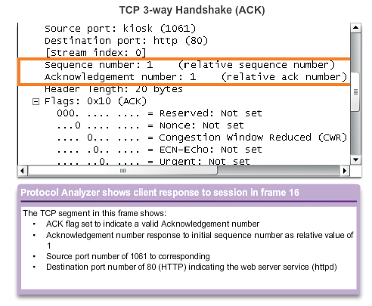
TCP Communication TCP Three-Way Handshake – Step 3
Step 3: The initiating client acknowledges the server-to-client communication session.
Notes:
7.2.1.6 TCP Three Way Handshake – Step 3

Slide 19
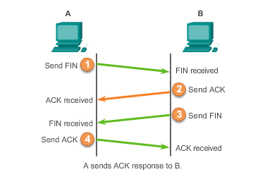
TCP Communication TCP Session Termination
Notes:
7.2.1.7 TCP Session Termination

Slide 20
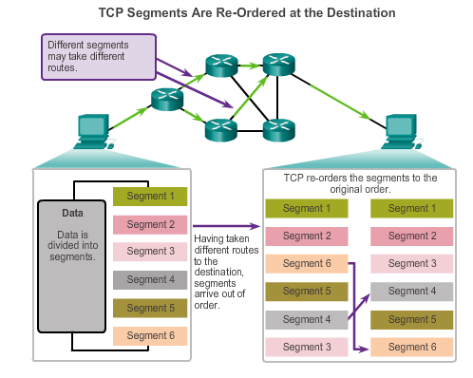
Reliability and Flow Control TCP Reliability – Ordered Delivery
Sequence numbers used to reassemble segments into original order
Notes:
7.2.2.1 TCP Reliability – Ordered Delivery

Slide 21
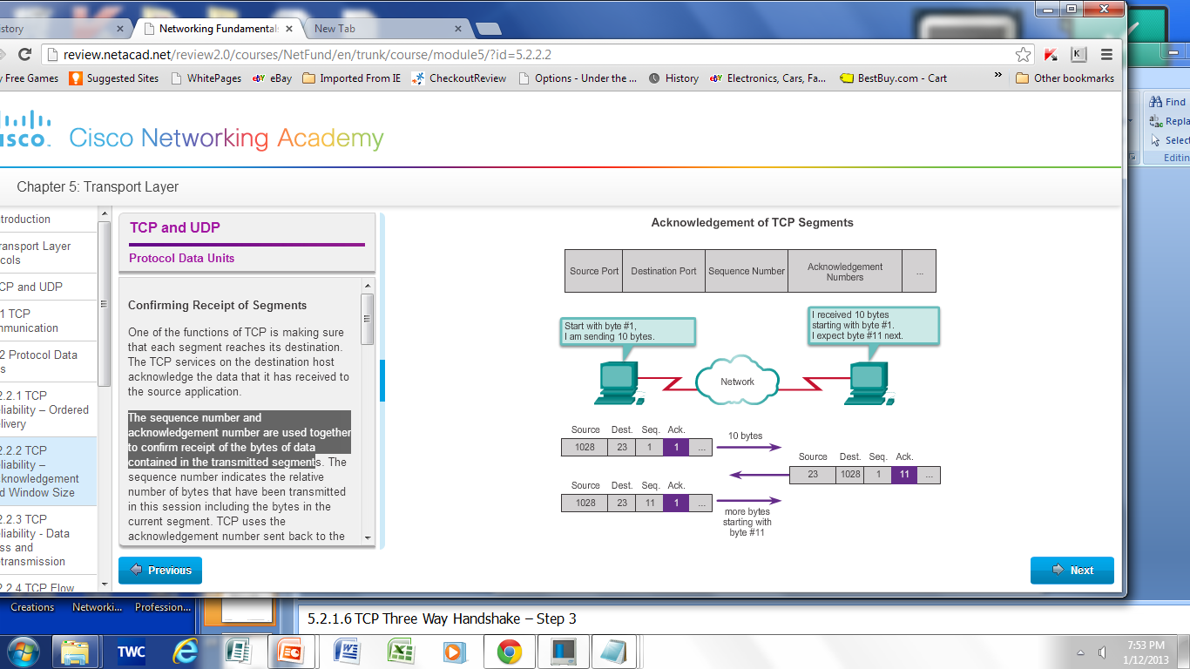
TCP Reliability – Acknowledgement and Window Size
The sequence number and acknowledgement number are used together to confirm receipt.
Window Size - The amount of data that a source can transmit before an acknowledgement must be received.
Notes:
7.2.2.2 TCP Reliability –Acknowledgement and Window size

Slide 22
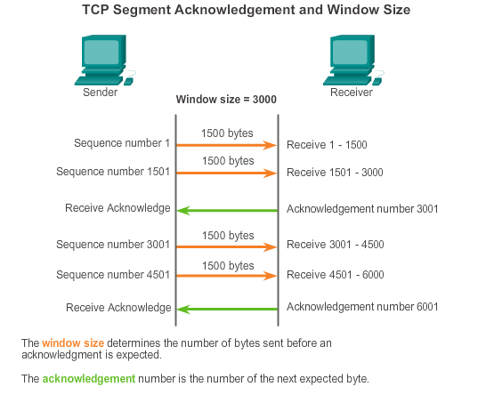
TCP Reliability and Flow Control Window Size and Acknowledgements
Notes:
7.2.2.4 TCP Flow Control- Window Size and Acknowledgements

Slide 23
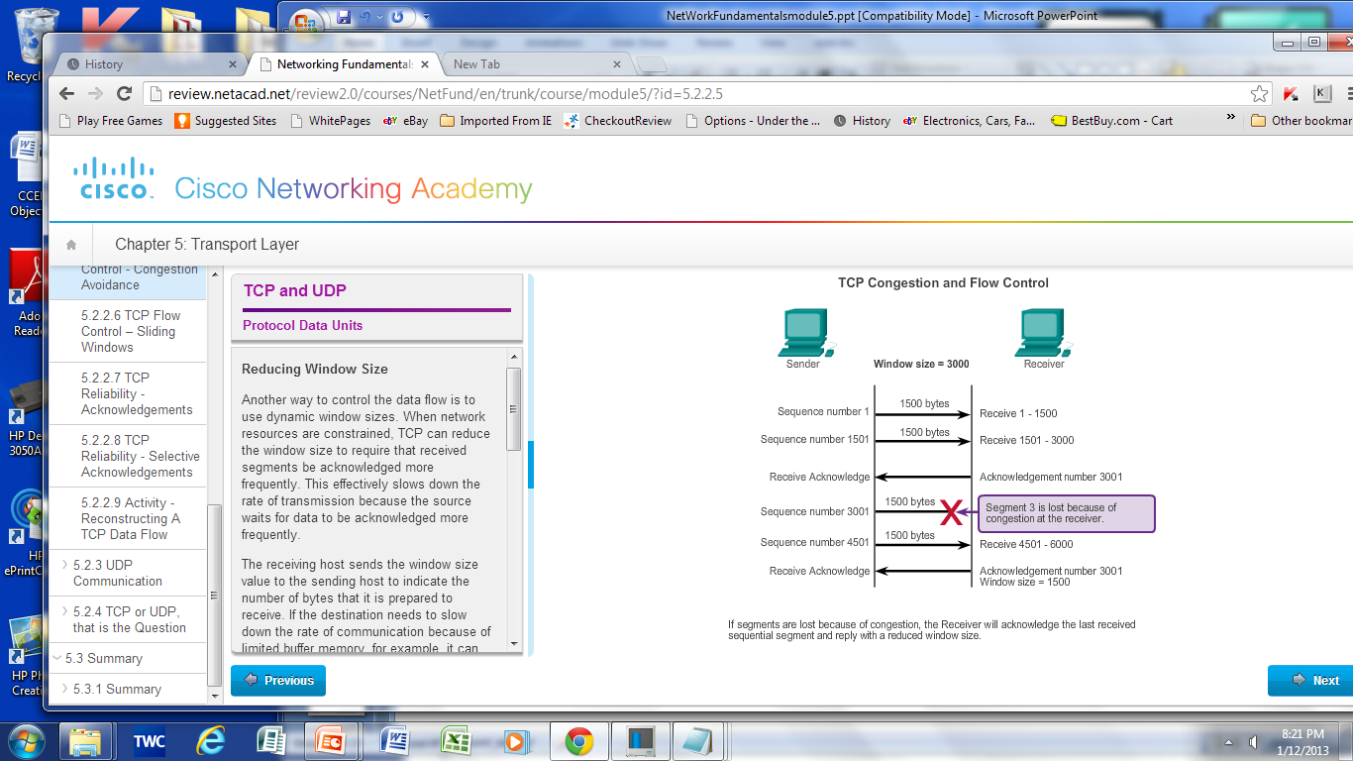
Reliability and Flow Control TCP Flow Control – Congestion Avoidance
Notes:
7.2.2.5 TCP Flow Control –Congestion Avoidance

Slide 24
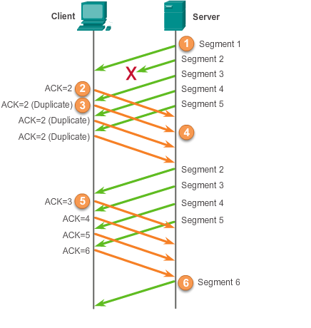
Reliability and Flow Control TCP Reliability - Acknowledgements
Notes:
7.2.2.6 TCP Reliability - Acknowledgements

Slide 25
UDP Communication UDP Low Overhead vs. Reliability
UDP
Simple protocol that provides the basic transport layer functions
Used by applications that can tolerate small loss of data
Used by applications that cannot tolerate delay
Used by
Domain Name System (DNS)
Simple Network Management Protocol (SNMP)
Dynamic Host Configuration Protocol (DHCP)
Trivial File Transfer Protocol (TFTP)
IP telephony or Voice over IP (VoIP)
Online games
Notes:
7.2.3 UDP Communication
7.2.3.1 UDP Low Overhead vs. Reliability

Slide 26
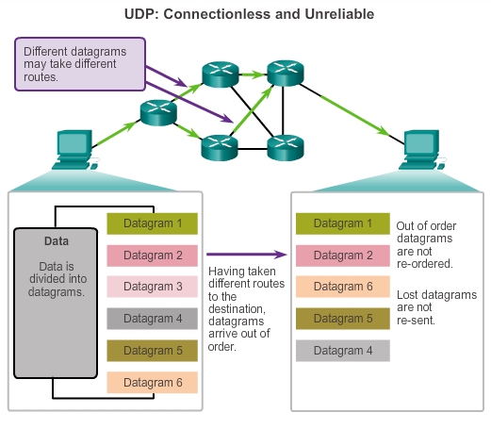
UDP Communication Datagram Reassembly
Notes:
7.2.3.2 Datagram Reassembly

Slide 27
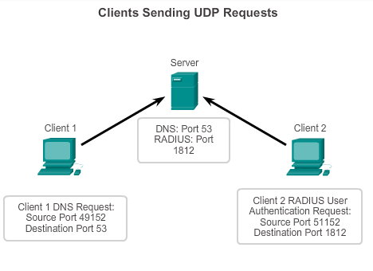
UDP Communication UDP Server and Client Processes
UDP-based server applications are assigned well-known or registered port numbers.
UDP client process randomly selects port number from range of dynamic port numbers as the source port.
Notes:
7.2.3.3 UDP Server Processes and Requests
7.2.3.4 UDP Client Processes

Slide 28
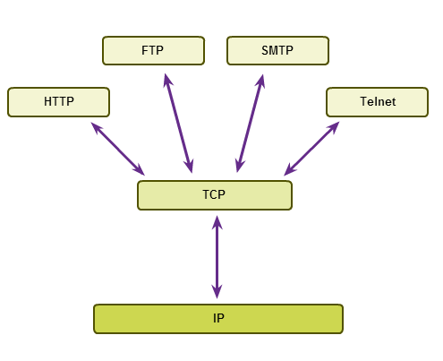
TCP or UDP Applications that use TCP
Notes:
7.2.4 TCP or UDP, that is the Question
7.2.4.1 Applications that use TCP

Slide 29
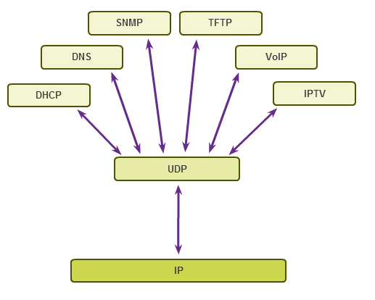
TCP or UDP Applications that use UDP
Notes:
7.2.4 TCP or UDP, that is the Question
7.2.4.2 Applications that use UDP

Slide 30
Chapter 7: Summary
The role of the Transport layer is to provide three main functions: multiplexing, segmentation and reassembly, and error checking.
These functions are necessary in order to address issues in quality of service and security on networks.
Knowing how TCP and UDP operate and which popular applications use each protocol will allow the implementation of quality of service and build more reliable networks.
Ports provide a “tunnel” for data to get from the Transport layer to the appropriate application at the destination.

Slide 31


